Slide 1
MGS 723: Geodynamics
Class 7: Brittle failure

Slide 2
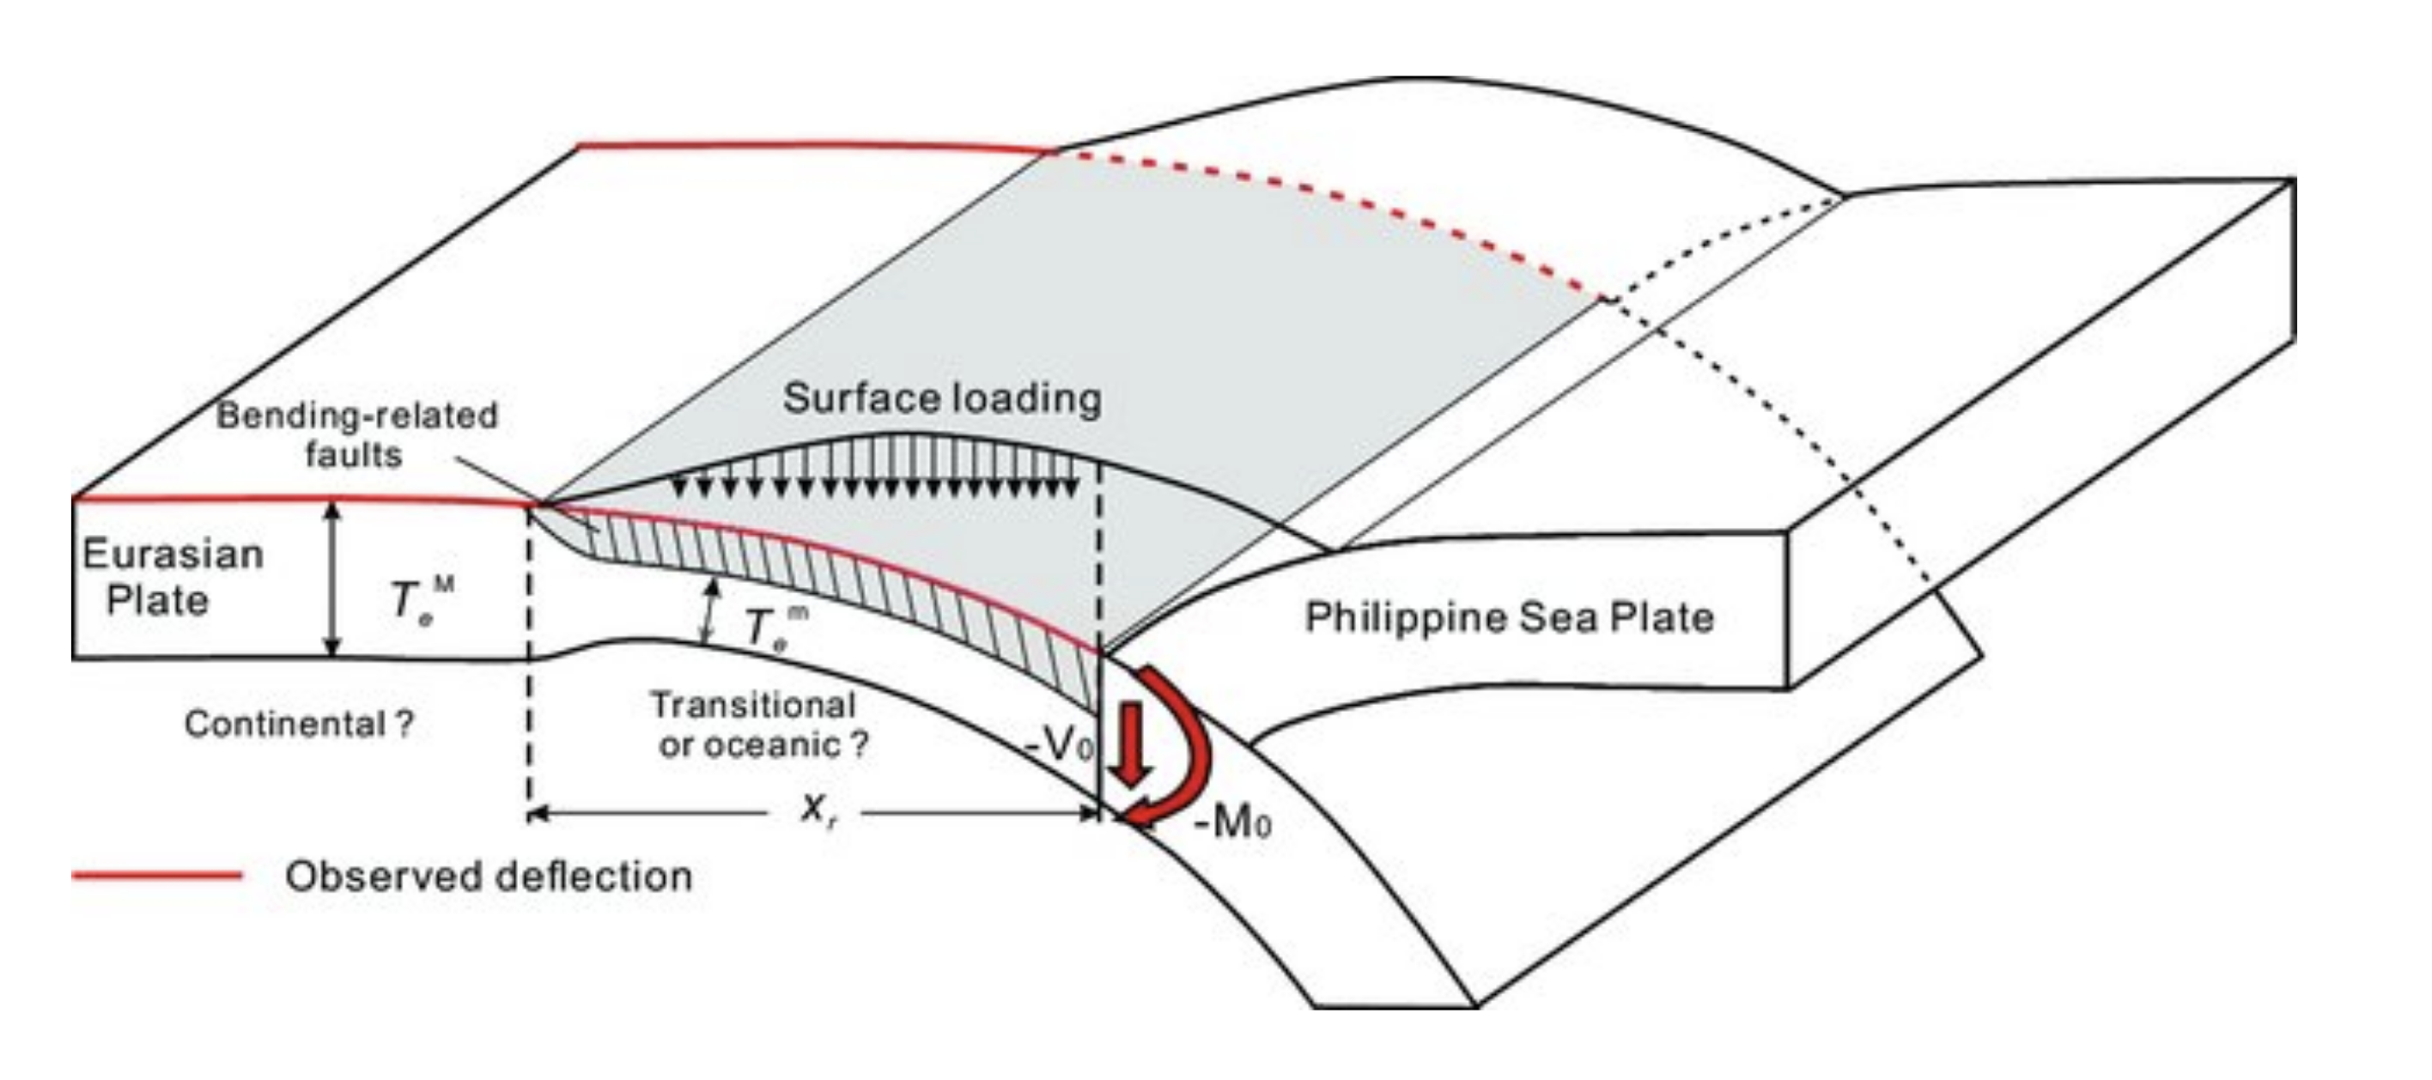
Brittle failure
Elasticity often an oversimplification:
e.g., we detect faulting in regions of high stress during plate bending

Slide 3
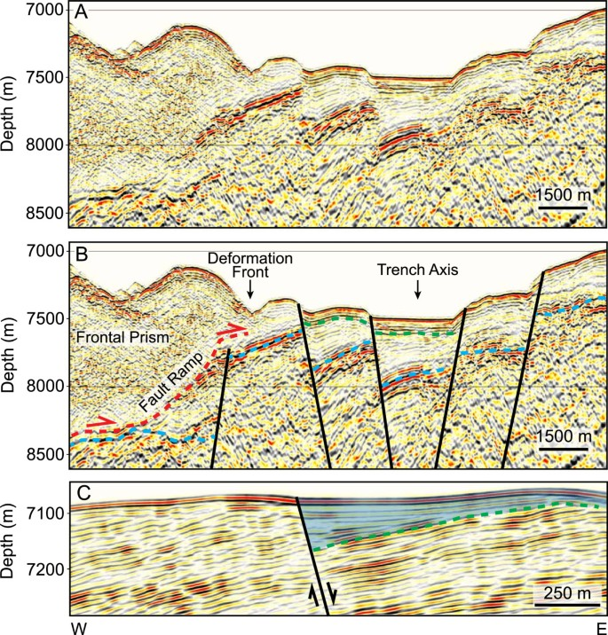
Brittle failure
Elasticity often an oversimplification:
e.g., we detect faulting in regions of high stress during plate bending
faulting

Slide 4
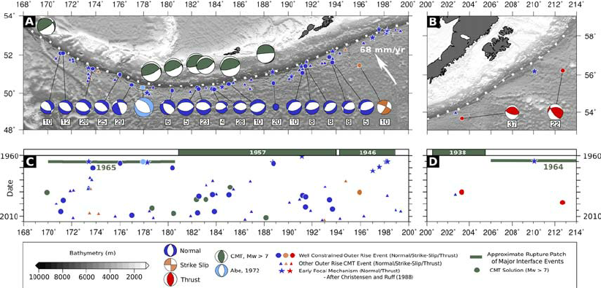
Brittle failure
Elasticity often an oversimplification:
e.g., we detect faulting in regions of high stress during plate bending
faulting
earthquakes

Slide 5
Brittle failure
At a certain high stress, the continuum breaks apart and faulting/brittle failure occurs.

Slide 6
Brittle failure
At a certain high stress, the continuum breaks apart and faulting/brittle failure occurs.
Typically, another type of deformation occurs at stress < failure stress (e.g., elastic, viscous). Once the failure stress is hit, the material breaks.

Slide 7
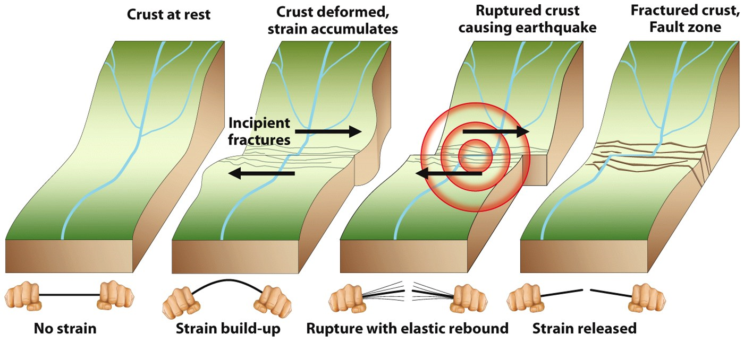
Brittle failure
At a certain high stress, the continuum breaks apart and faulting/brittle failure occurs.
Typically, another type of deformation occurs at stress < failure stress (e.g., elastic, viscous). Once the failure stress is hit, the material breaks.

Slide 8
Initiating brittle failure
Considering bonds between atoms of a homogeneous medium, one would expect failure at ∼ 30 GPa (Elastic Modulus) for rocks at Earth’s surface.
However, failure usually occurs at much lower stresses, ∼ 100 MPa (see Navier-Coulomb law)

Slide 9
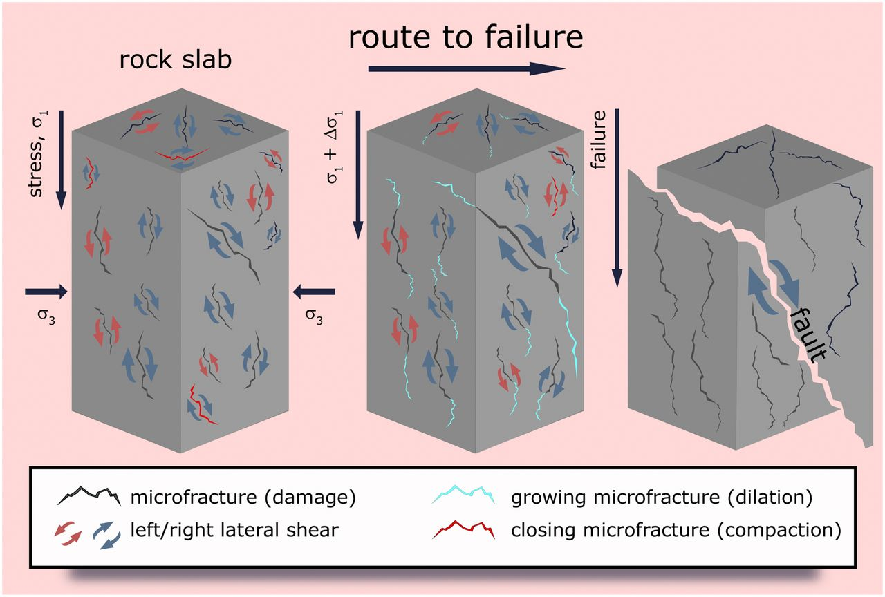
Initiating brittle failure
Considering bonds between atoms of a homogeneous medium, one would expect failure at ∼ 30 GPa (Elastic Modulus) for rocks at Earth’s surface.
However, failure usually occurs at much lower stresses, ∼ 100 MPa (see Navier-Coulomb law)
Due to impurities and defects, e.g., micro-cracks, which localize stress. Cracks link up to form macroscopic sliding surfaces which break the rock in a brittle fashion.

Slide 10
Initiating brittle failure
Considering bonds between atoms of a homogeneous medium, one would expect failure at ∼ 30 GPa (Elastic Modulus) for rocks at Earth’s surface.
However, failure usually occurs at much lower stresses, ∼ 100 MPa (see Navier-Coulomb law)
Due to impurities and defects, e.g., micro-cracks, which localize stress. Cracks link up to form macroscopic sliding surfaces which break the rock in a brittle fashion.
This is a very complicated set of processes (see: fracture mechanics).
But can develop empirical experiments in the laboratory (see: rock mechanics).

Slide 11
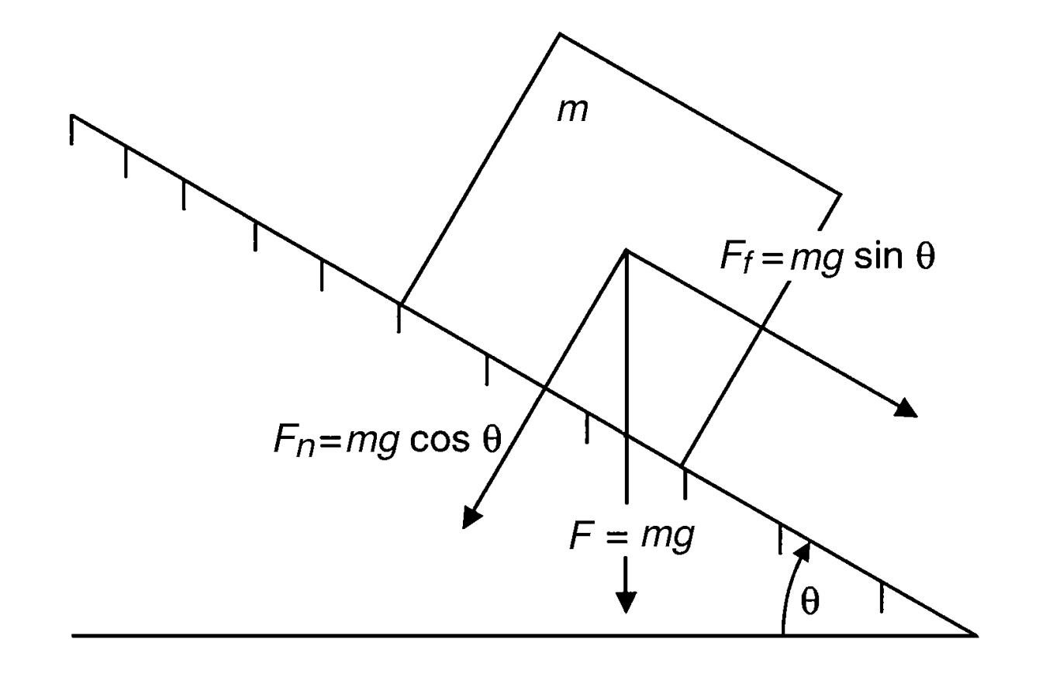
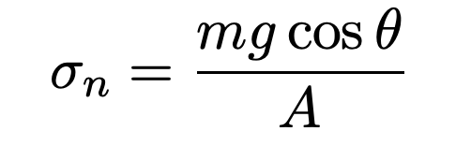
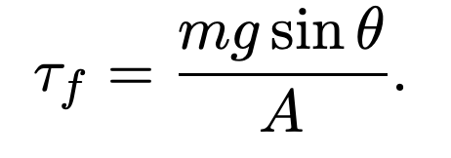
Frictional sliding along pre-existing planes
Normal stress on surface:
Shear stress on surface:

Slide 12

Frictional sliding along pre-existing planes
Normal stress on surface:
Shear stress on surface:
Slip occurs when:$τ_{f}= τ_{fs}$ ($τ_{fs}$ is static frictional stress)

Slide 13


Frictional sliding along pre-existing planes
Normal stress on surface:
Shear stress on surface:
Slip occurs when:$τ_{f}= τ_{fs}$ ($τ_{fs}$ is static frictional stress)
Experiments:$τ_{fs}=fσ_{n}$
(Amontons' law)

Slide 14

Frictional sliding along pre-existing planes
Normal stress on surface:
Shear stress on surface:
Slip occurs when:$τ_{f}= τ_{fs}$ ($τ_{fs}$ is static frictional stress)
Experiments:$τ_{fs}=fσ_{n}$ [f is coefficient of static friction = tan($θ)]$
(Amontons' law)

Slide 15
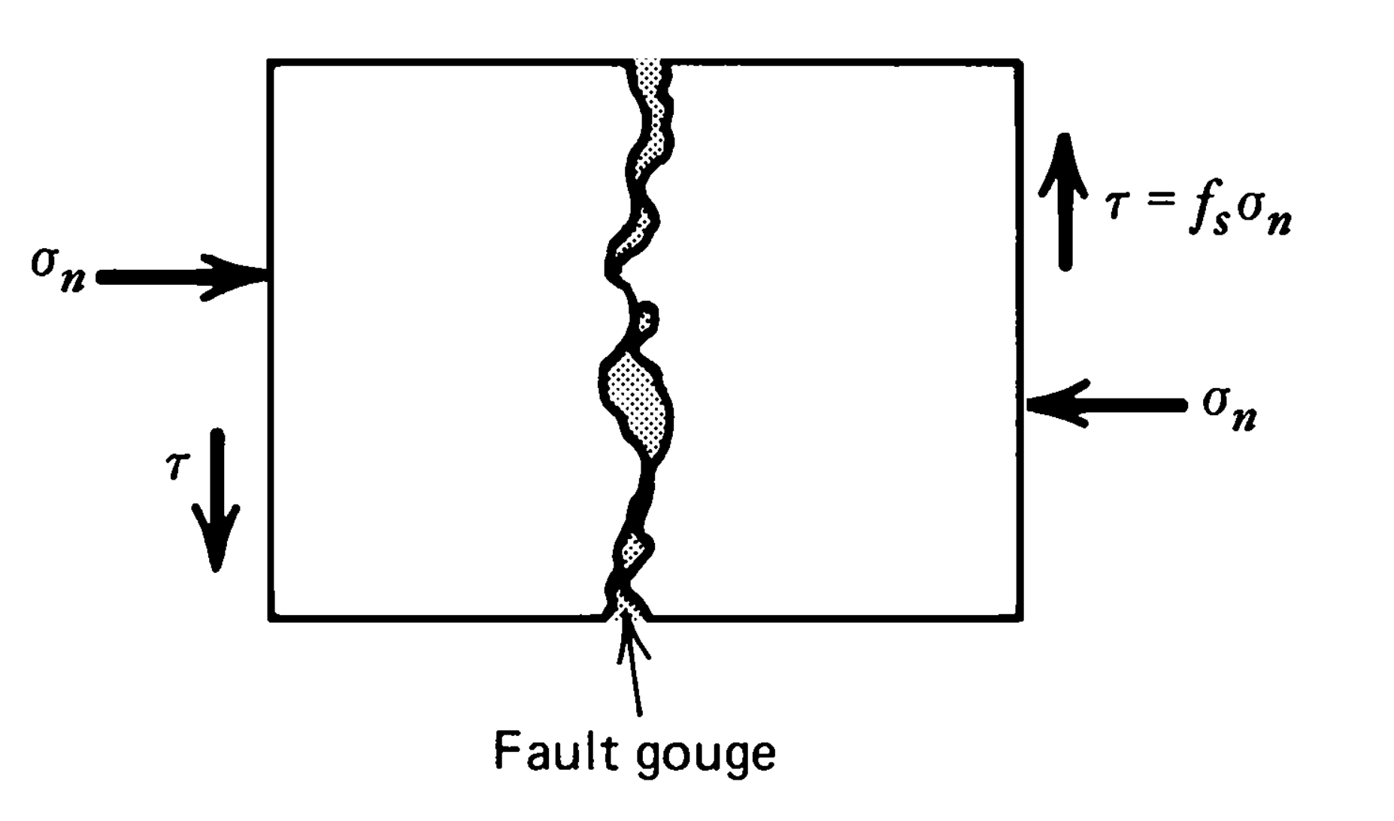
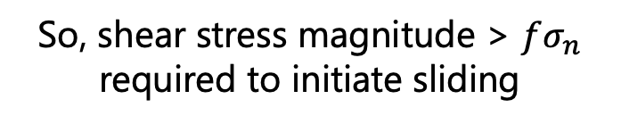
Frictional sliding along pre-existing planes
So, shear stress magnitude > $fσ_{n}$ required to initiate sliding

Slide 16
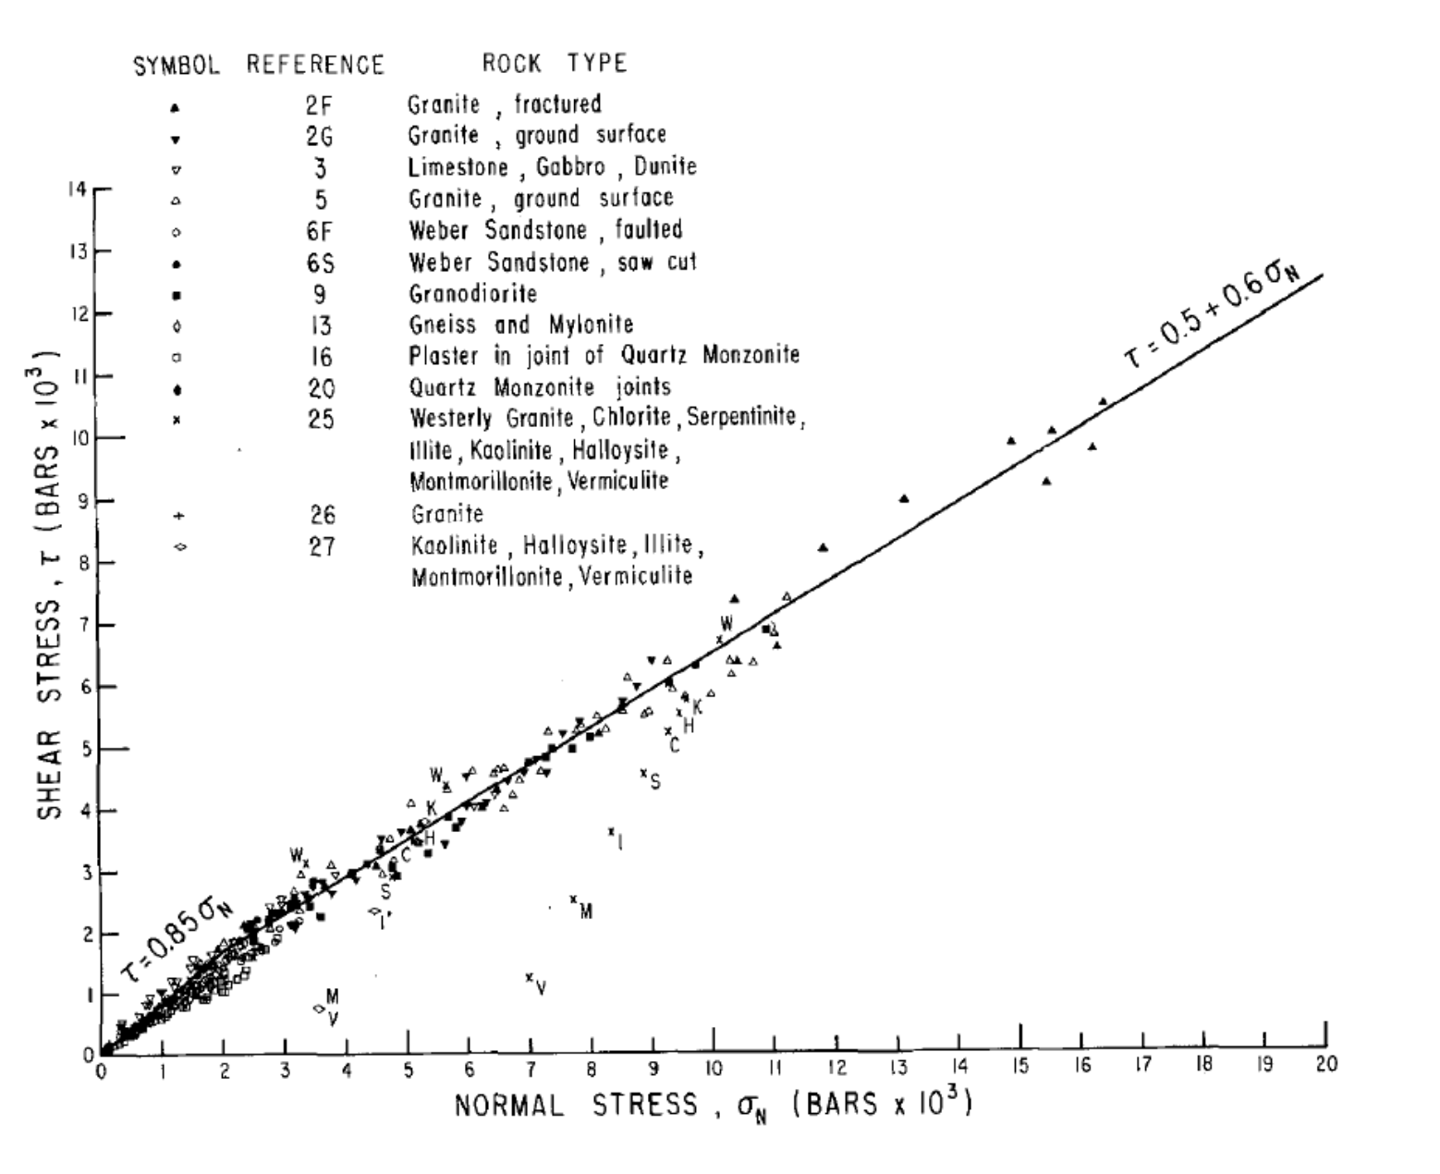
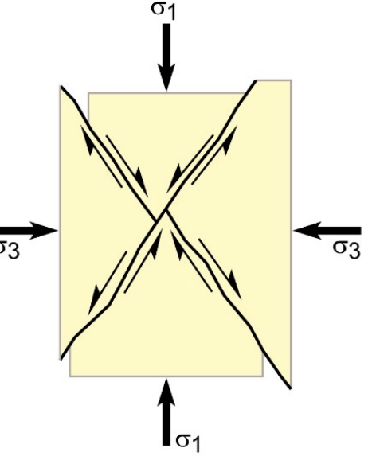
Byerlee’s Law
Byerlee, 1978
Experimental results for frictional sliding stress of a range of rocks with pre-cut fault surfaces as a function of normal stress (1 kbar = 100 MPa) at higher pressures
Notes:
A cylinder of rock is axially compressed under constant confining pressure. The axial load is gradually increased until the rock fails.

Slide 17
Byerlee’s Law
Byerlee, 1978
Relative to Amonton’s Law, there is also a stress independent component of shear strength: The cohesive strength of the material, C
Notes:
The cohesive strength of a material is the strength of bonding between the particles or surfaces that make up that material (Keary 1996). In rock mechanics the cohesive strength is more specifically the inherent shear strength of a plane across which there is no normal stress (Keary 1996)

Slide 18
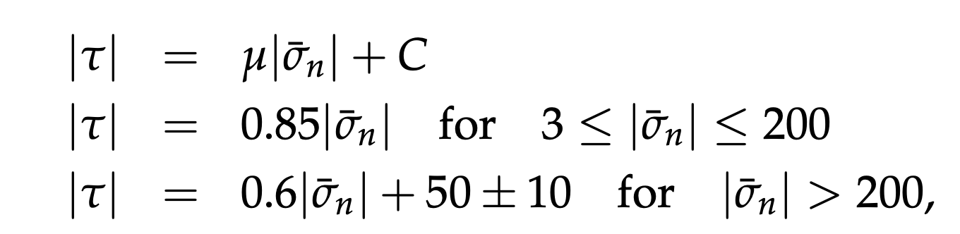

Byerlee’s Law
Frictional sliding on an existing fault plane
(Stresses in MPa)
Minimal variation with rock type
$μ= f_{s}=$ coefficient of friction
C = Cohesion or Cohesive strength
(Also see Mohr-Coulomb theory)

Slide 19
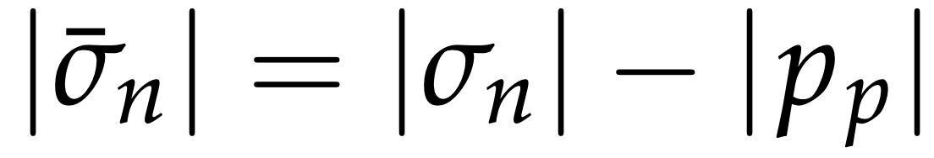
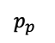
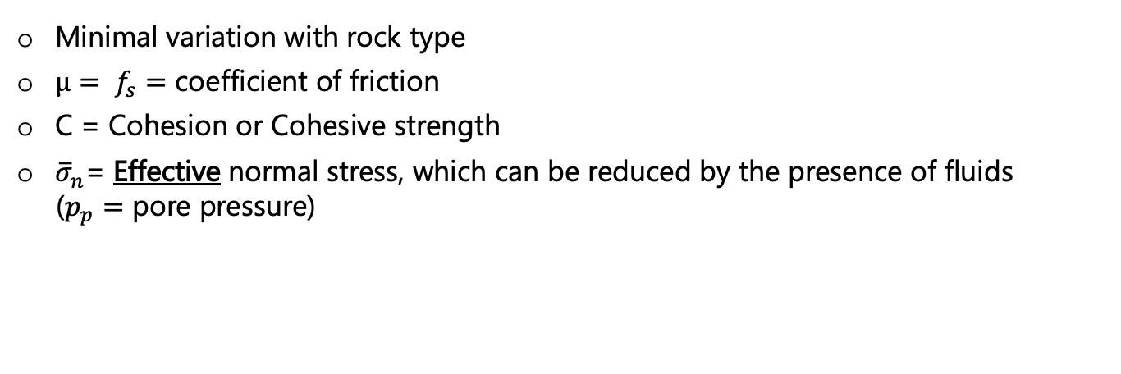
Byerlee’s Law
Frictional sliding on an existing fault plane
(Stresses in MPa)
Minimal variation with rock type
$μ= f_{s}=$ coefficient of friction
C = Cohesion or Cohesive strength
${\overline{σ}}_{n}$= Effective normal stress, which can be reduced by the presence of fluids
($p_{p}=$ pore pressure)
$p_{p}$

Slide 20
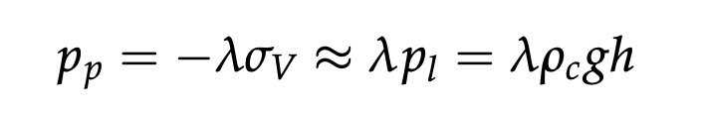
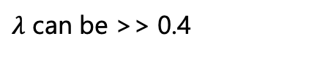
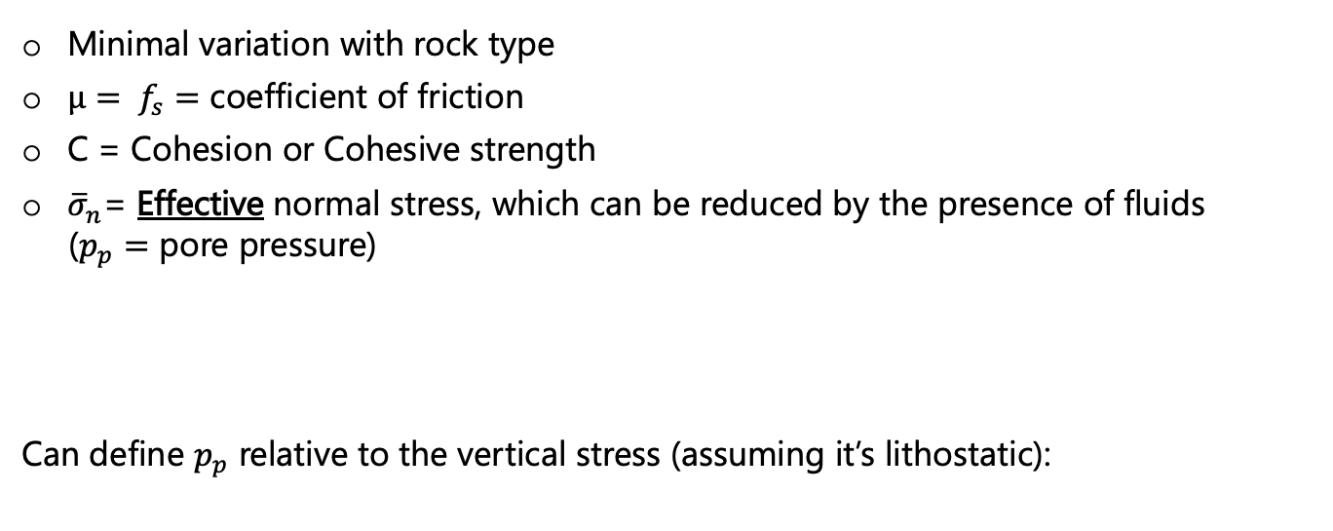
Byerlee’s Law
Frictional sliding on an existing fault plane
(Stresses in MPa)
Minimal variation with rock type
$μ= f_{s}=$ coefficient of friction
C = Cohesion or Cohesive strength
${\overline{σ}}_{n}$= Effective normal stress, which can be reduced by the presence of fluids
($p_{p}=$ pore pressure)
Can define $p_{p}$ relative to the vertical stress (assuming it’s lithostatic):
$p_{p}$
$λ$ can be >> 0.4

Slide 21
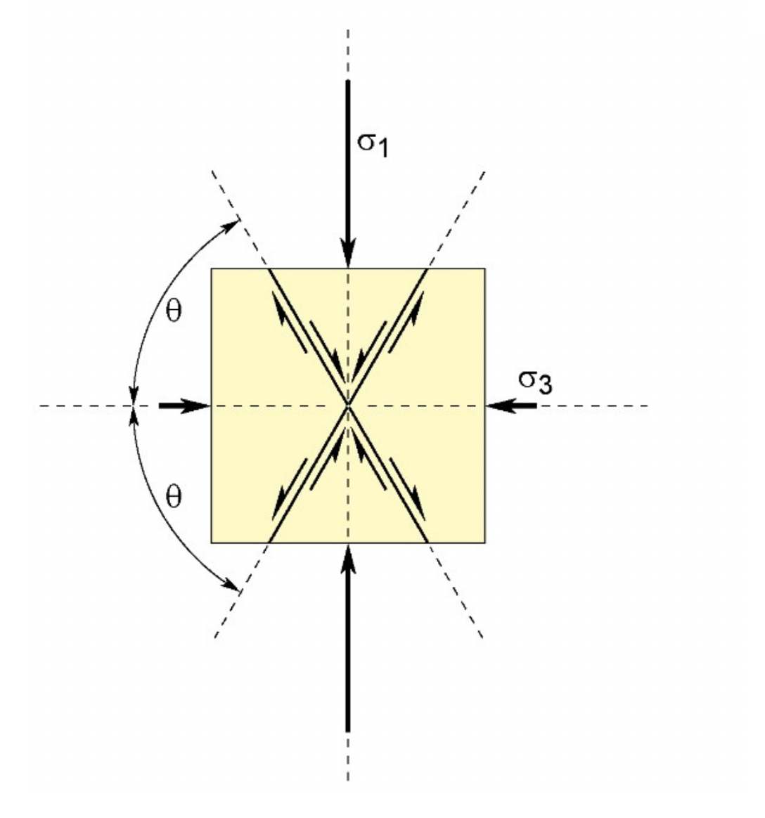
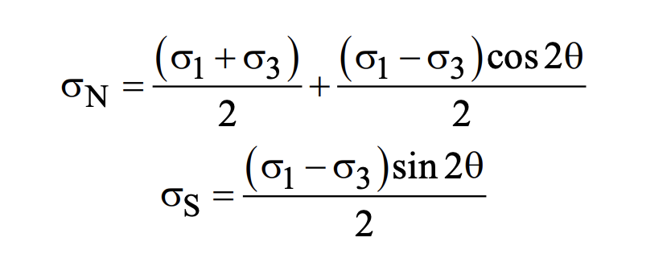

Normal and shear stress on an arbitrary plane
T&S: Eqs. 2-56 – 2-58
(Here, we neglect $σ_{2}$)
Note: Two planes of maximum shear stress
(= conjugate faults)

Slide 22
Normal and shear stress on an arbitrary plane
T&S: Eqs. 2-56 – 2-58
(Here, we neglect $σ_{2}$)
Note: Two planes of maximum shear stress
(= conjugate faults)
How can we combine this with faulting criteria?

Slide 23
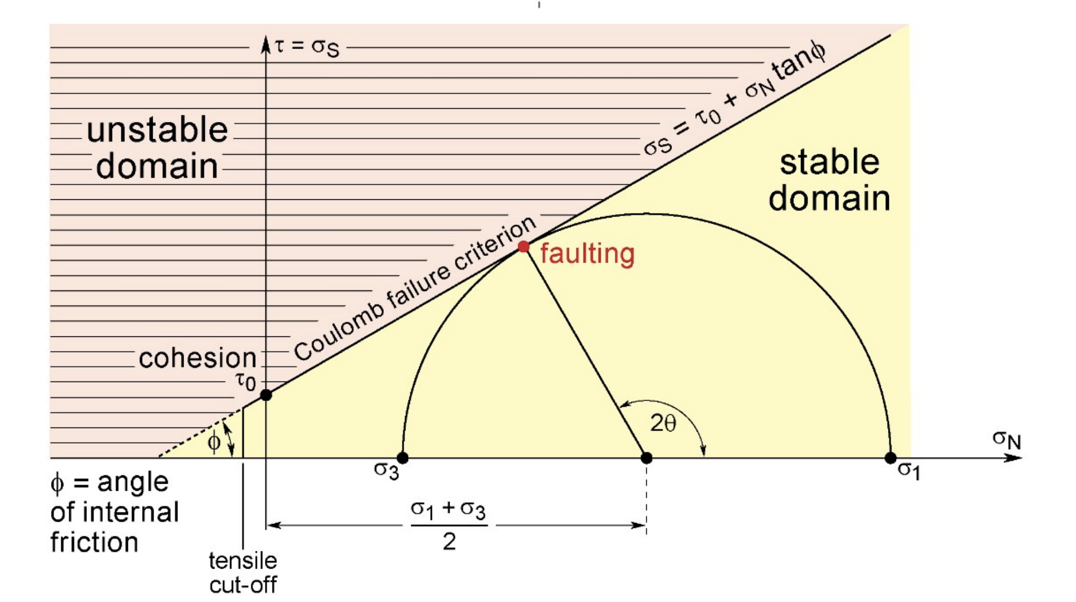
Using a Mohr’s Circle diagram!
J-P Burg (ETHZ)

Slide 24
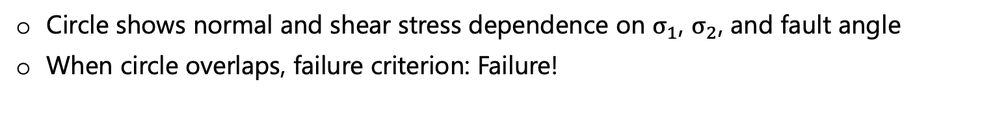
Mohr’s Circle
J-P Burg (ETHZ)
Circle shows normal and shear stress dependence on $σ_{1}$, $σ_{2}$, and fault angle
When circle overlaps, failure criterion: Failure!

Slide 25
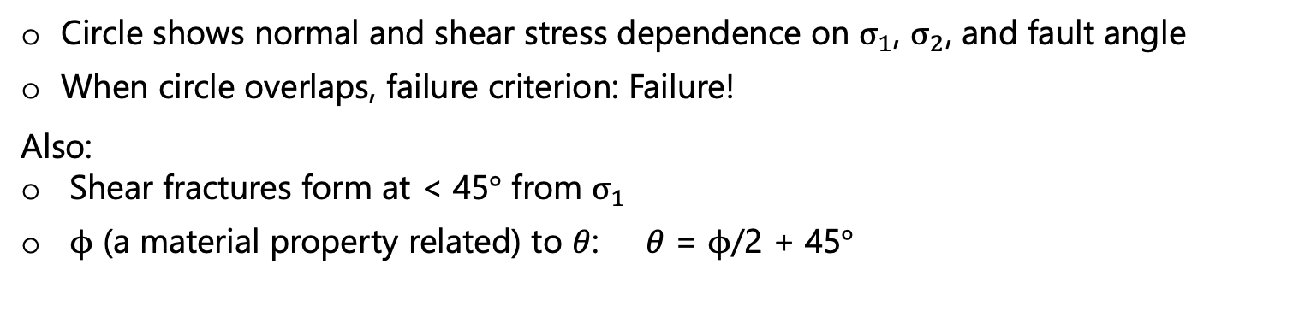
Mohr’s Circle
J-P Burg (ETHZ)
Circle shows normal and shear stress dependence on $σ_{1}$, $σ_{2}$, and fault angle
When circle overlaps, failure criterion: Failure!
Also:
Shear fractures form at < 45$°$ from $σ_{1}$
$ϕ$ (a material property related) to $θ$: $θ$ = $ϕ$/2 + 45$°$

Slide 26
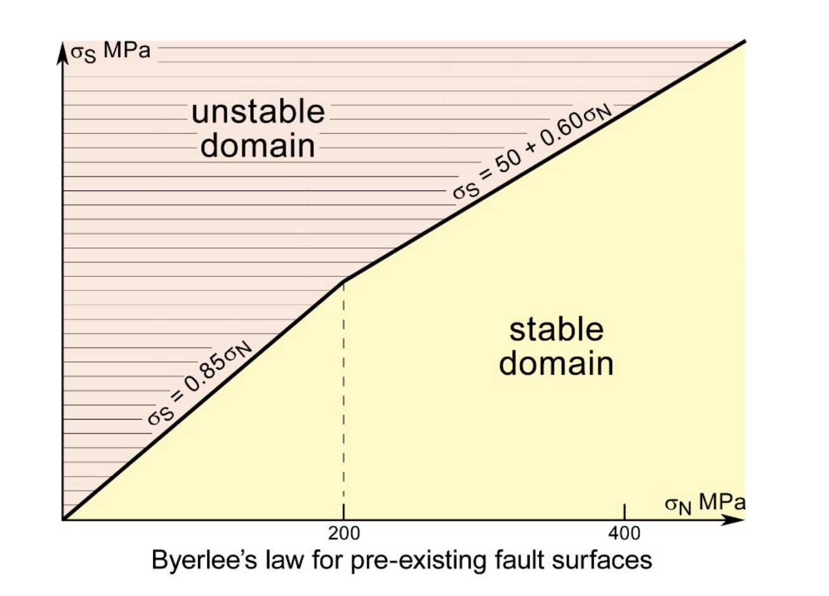

Mohr’s Circle
J-P Burg (ETHZ)
Circle shows normal and shear stress dependence on $σ_{1}$, $σ_{2}$, and fault angle
When circle overlaps, failure criterion: Brittle failure!
Also:
Shear fractures form at <45$°$ from $σ_{1}$
$ϕ$ (a material property related) to $θ$: $θ$ = $ϕ$/2 + 45$°$
Incorporating Byerlee’s Law
(more realistic for rocks)

Slide 27
Mohr’s Circle
J-P Burg (ETHZ)
Circle shows normal and shear stress dependence on $σ_{1}$, $σ_{2}$, and fault angle
When circle overlaps, failure criterion: Brittle failure!
Also:
Shear fractures form at <45$°$ from $σ_{1}$
$ϕ$ (a material property related) to $θ$: $θ$ = $ϕ$/2 + 45$°$
Incorporating Byerlee’s Law
(more realistic for rocks)
How can we promote failure?

Slide 28
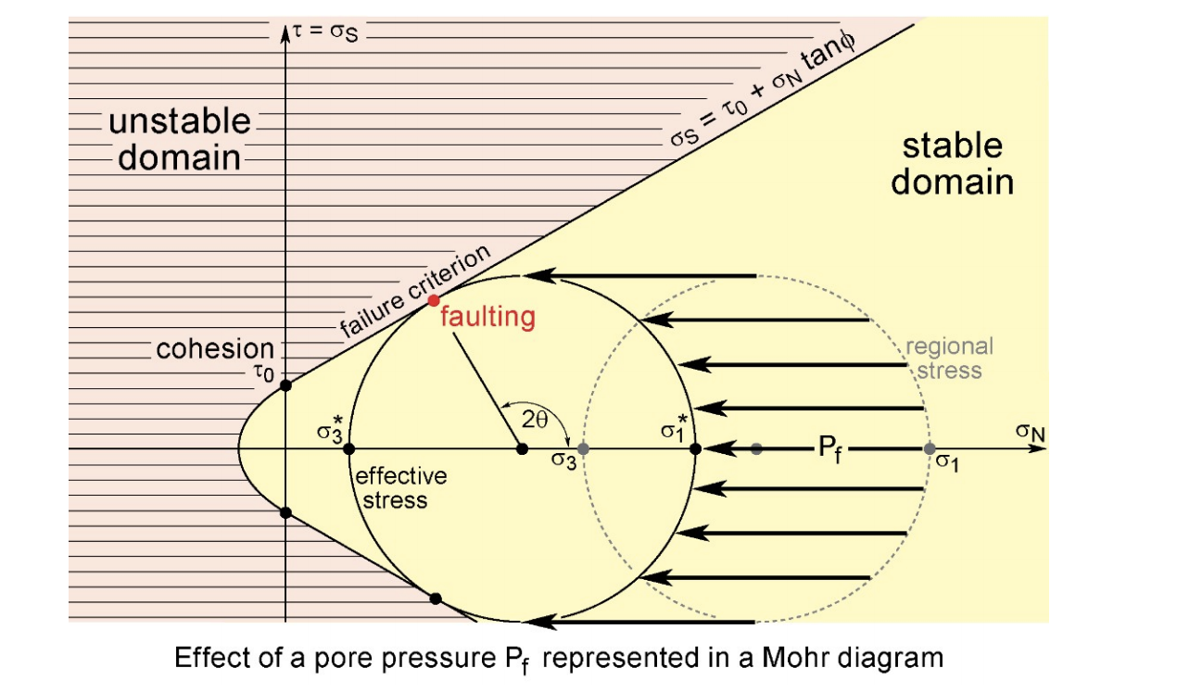
Mohr’s Circle
J-P Burg (ETHZ)
Increase pore pressure.

Slide 29
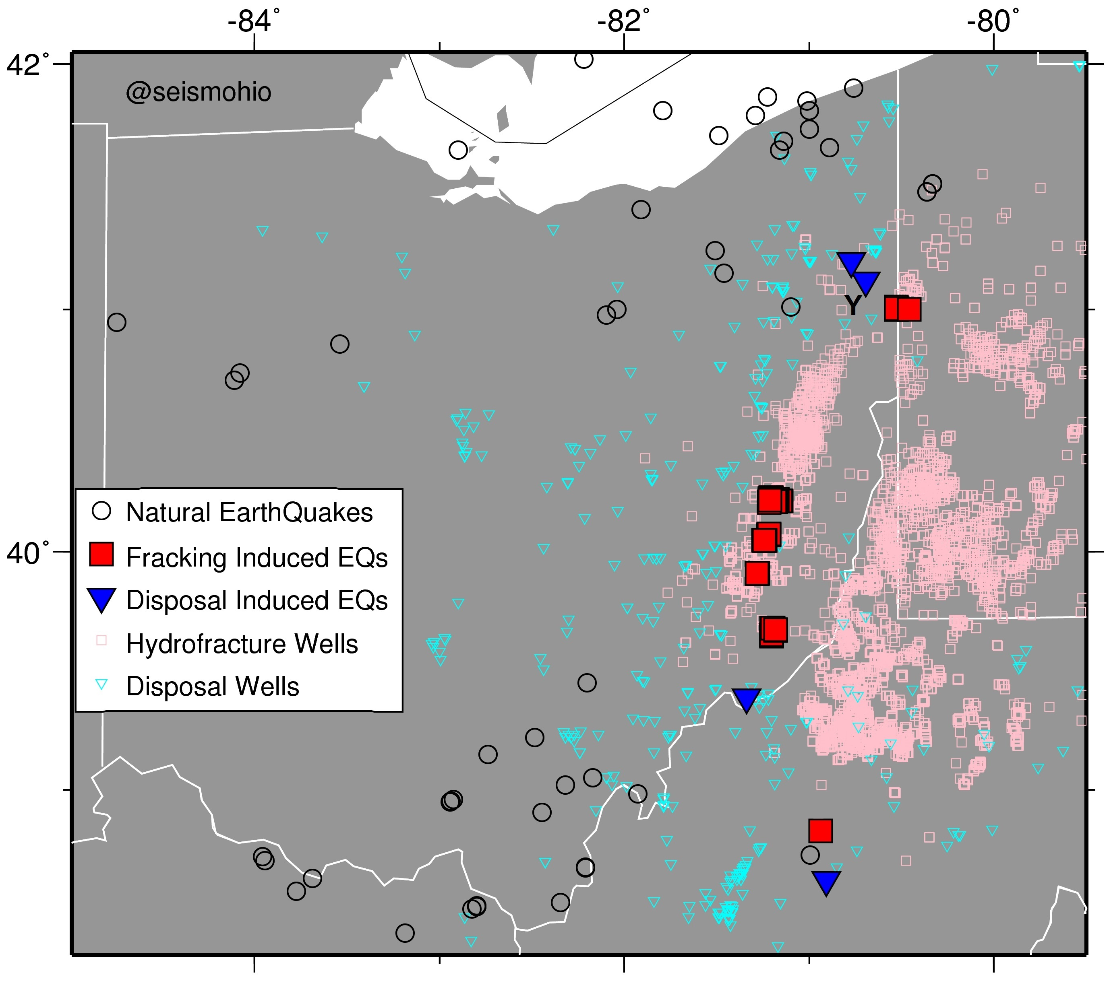
Mohr’s Circle
J-P Burg (ETHZ)
Induced seismicity in Ohio
Increase pore pressure.

Slide 30
Mohr’s Circle
J-P Burg (ETHZ)
Increase pore pressure.
Reduce rock pressure (e.g., move to shallow depths).

Slide 31

Mohr’s Circle
J-P Burg (ETHZ)
Increase pore pressure.
Reduce rock pressure (e.g., move to shallow depths).
Increase differential stress (reduce $σ_{3}$ or increase $σ_{1}$).

Slide 32
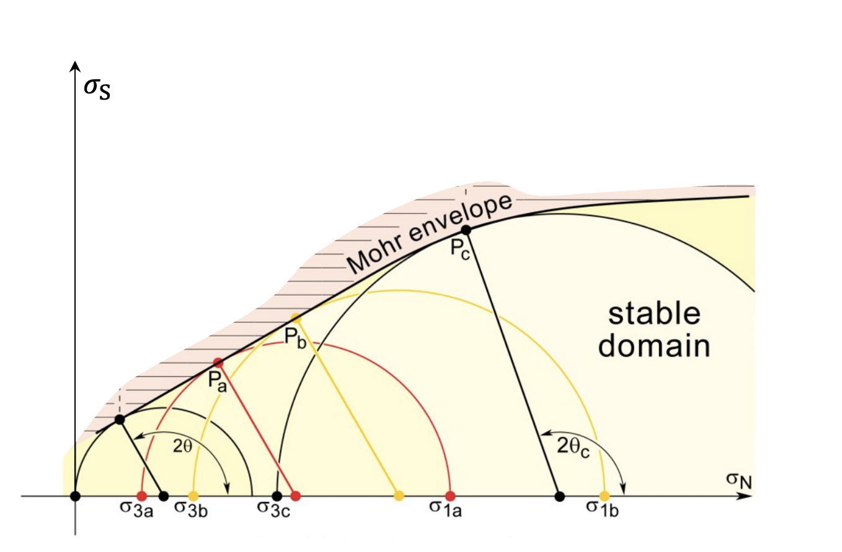
Plasticity

Slide 33
Plasticity
At high confining pressures, often transition to a different type of (ductile) failure: Plasticity
Notes:
-At high confining pressures, the envelope delineates a symmetrical pair of parallel and horizontal lines at a critical shear strength (Von Mises criterion), which means that the material becomes perfectly plastic, while the ductile flow is pressure-insensitive.
- The progressively decreasing slope with increasing pressure to horizontal at high pressure represents the progressive transition from brittle to ductile behavior.

Slide 34
Plasticity
At high confining pressures, often transition to a different type of (ductile) failure: Plasticity
Still kicks-in at a threshold stress: ”Yield Stress”
Instead of breaking, produces arbitrarily high amounts of deformation at constant stress (= yield strength).

Slide 35
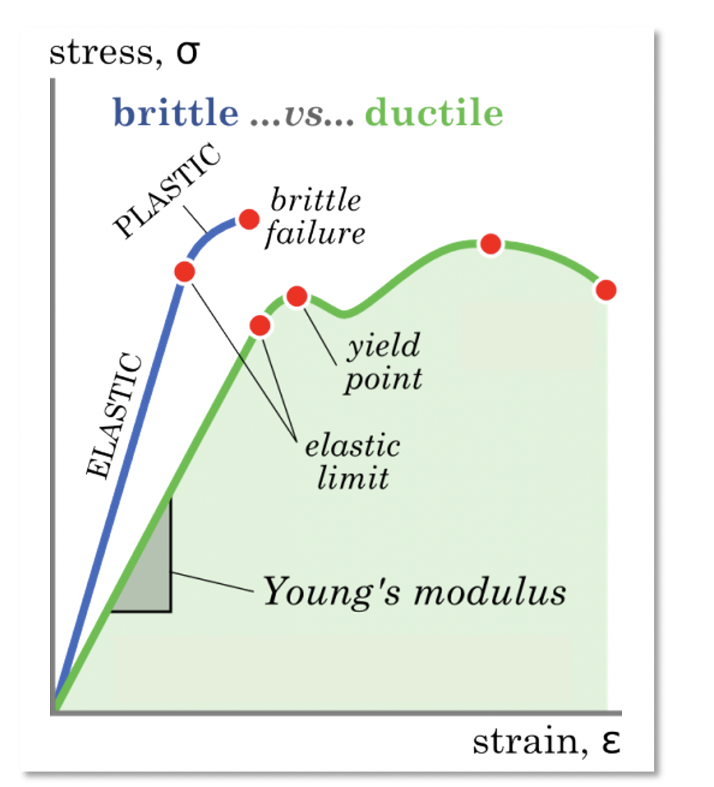
J-P Burg (ETHZ)
At high confining pressures, often transition to a different type of (ductile) failure: Plasticity
Still kicks-in at a threshold stress: ”Yield Stress”
Instead of breaking, produces arbitrarily high amounts of deformation at constant stress (= yield strength).

Slide 36
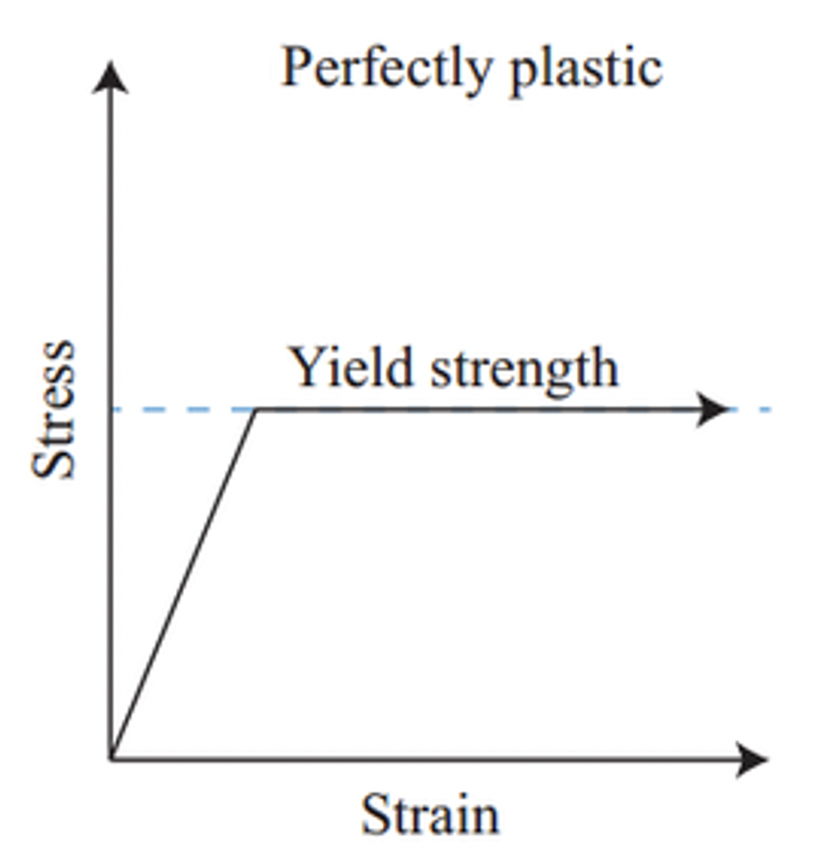
Plasticity
Perfectly plastic material is a solid that does not deform until a threshold strength = stress (the yield stress) is reached; the solid is incapable of maintaining stress greater than this critical value. At the yield stress, permanent and irreversible deformation proceeds continuously and indefinitely under constant stress (as for viscous deformation)
- J. P. Berg, 2020

Slide 37
Plasticity
An important example of plasticity in mantle rocks:
Peierls Creep

Slide 38
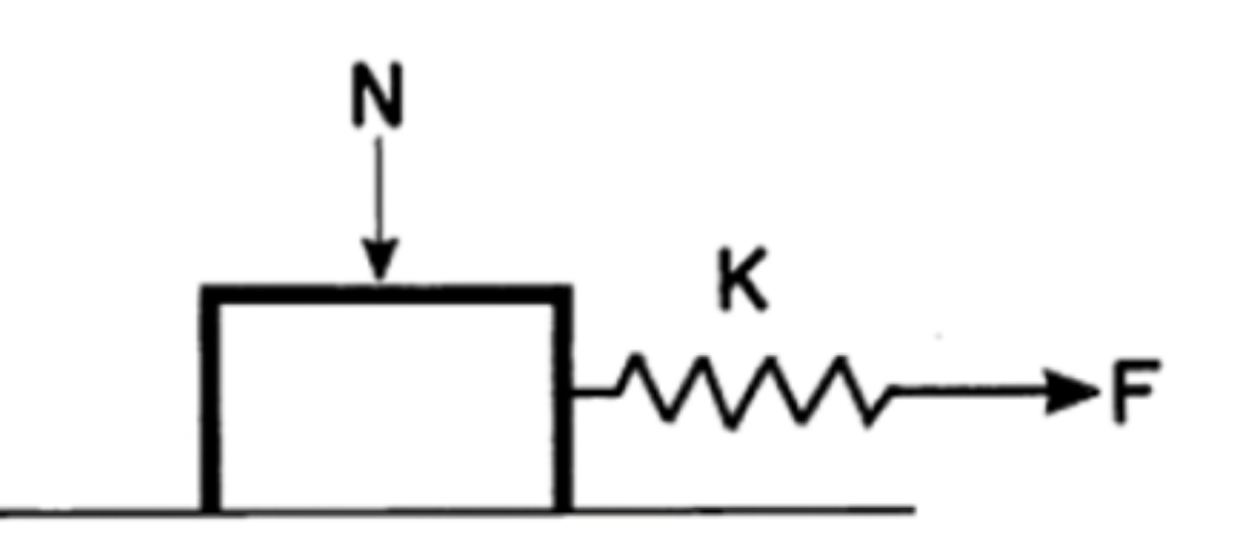
Plasticity
An important example of plasticity in mantle rocks:
Peierls Creep
In 1-D, elasto-plastic behavior described by a frictional slider:

Slide 39
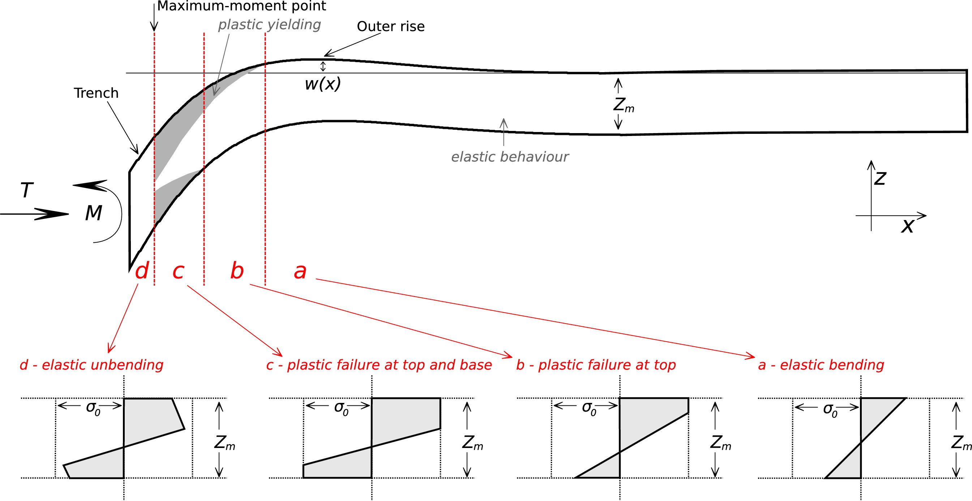
A few geodynamics applications…
Craig et al., 2014, EPSL
Can combine yield strength with elastic models to figure our where plastic deformation occurs in the lithosphere

Slide 40
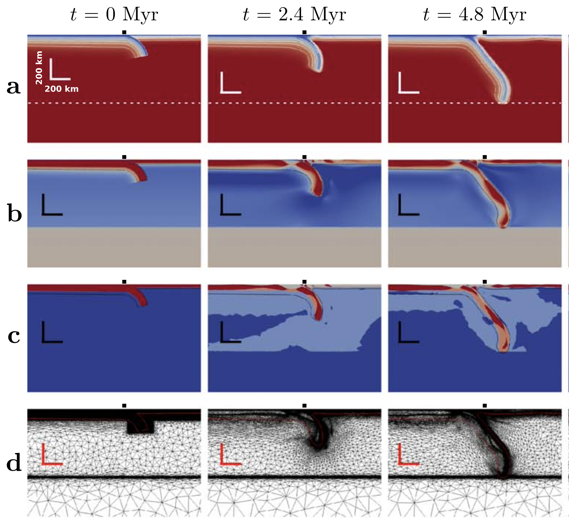
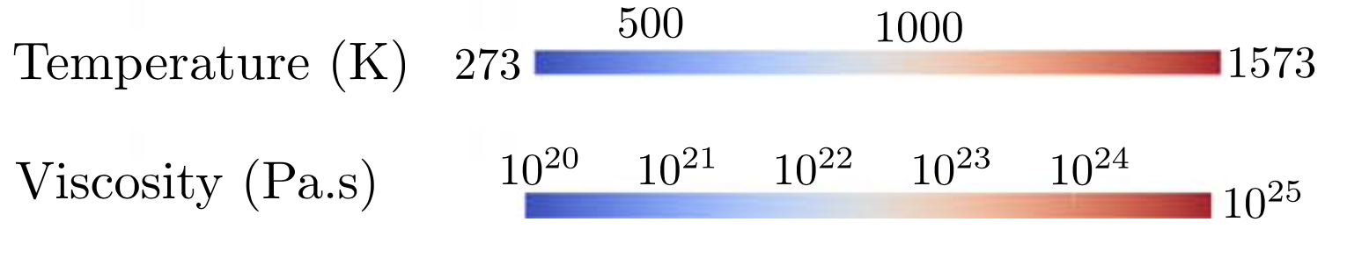
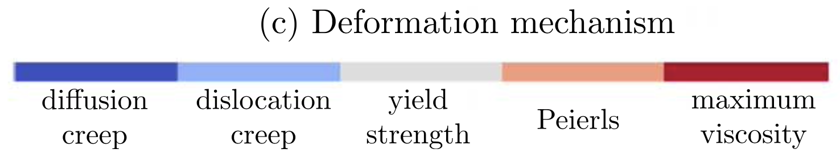
Geodynamics applications
Garel et al., 2014, G³
Can implement into geodynamic models to get a realistic rheological distribution: Subduction zones

Slide 41
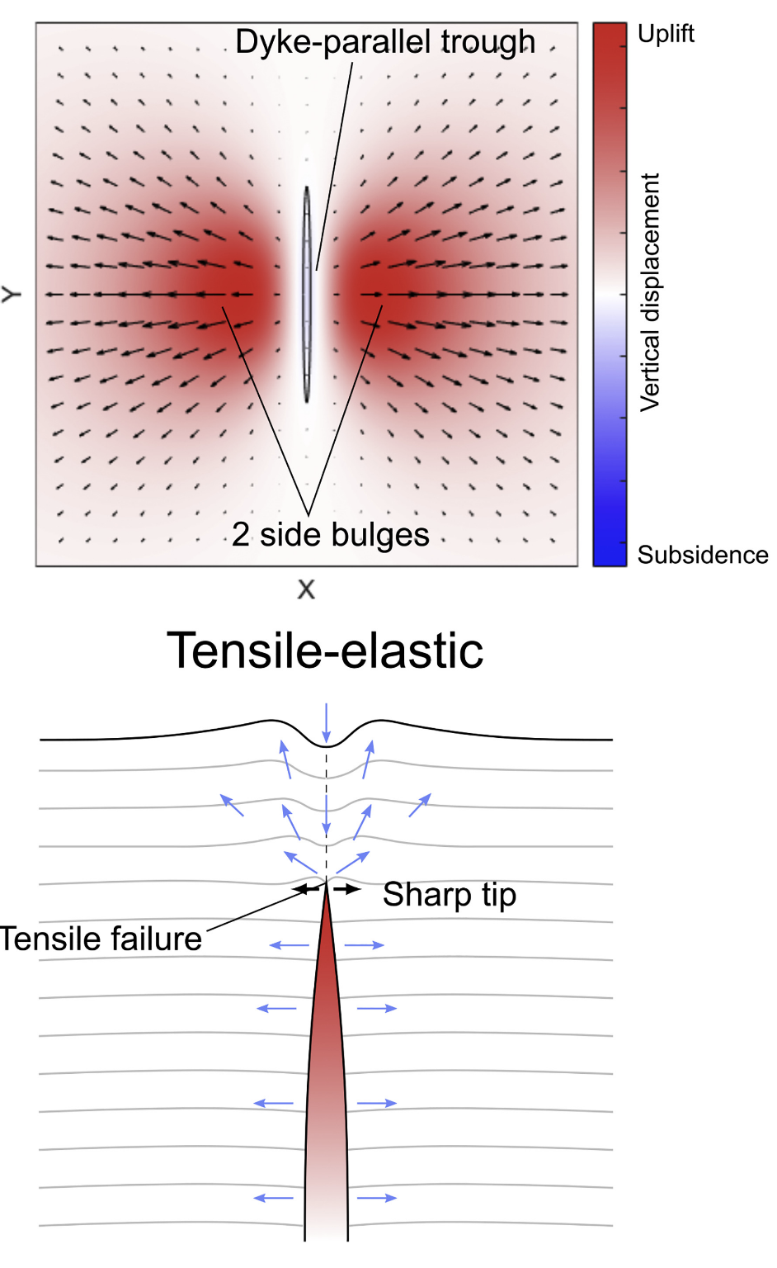
Geodynamics applications
Bertelsen et al., 2021, JVGR
Can implement into geodynamic models to get a realistic rheological distribution: Dyke emplacement

Slide 42
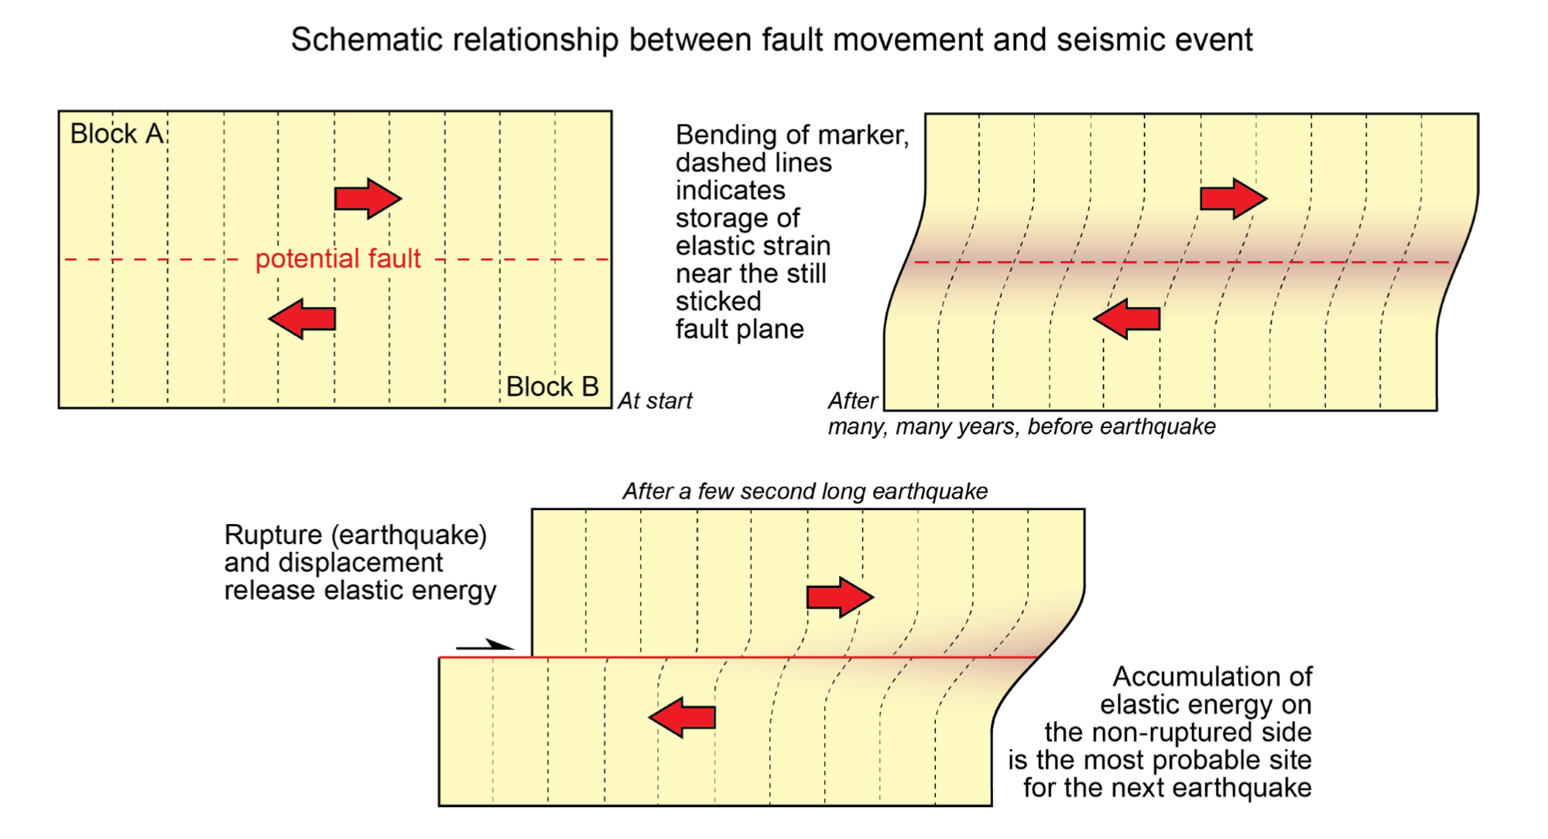
Geodynamics applications
Jean-Pierre Burg @ ETHZ
The Earthquake Cycle

Slide 43
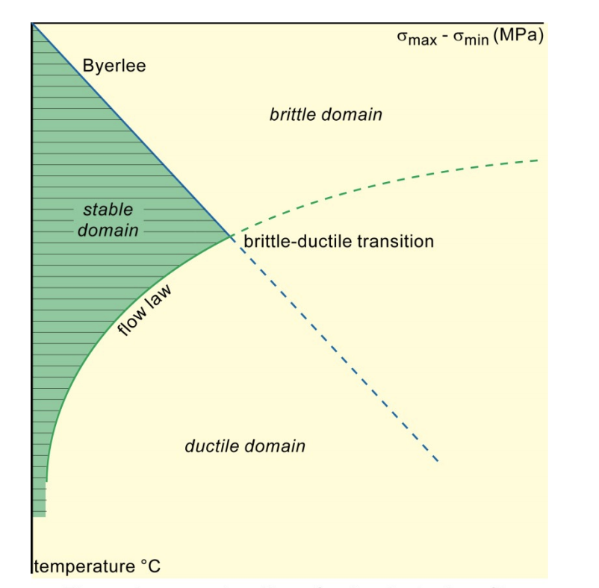
Geodynamics applications
One material
Jean-Pierre Burg @ ETHZ
Lithosphere strength profiles
(aka: Yield-strength envelopes)

Slide 44
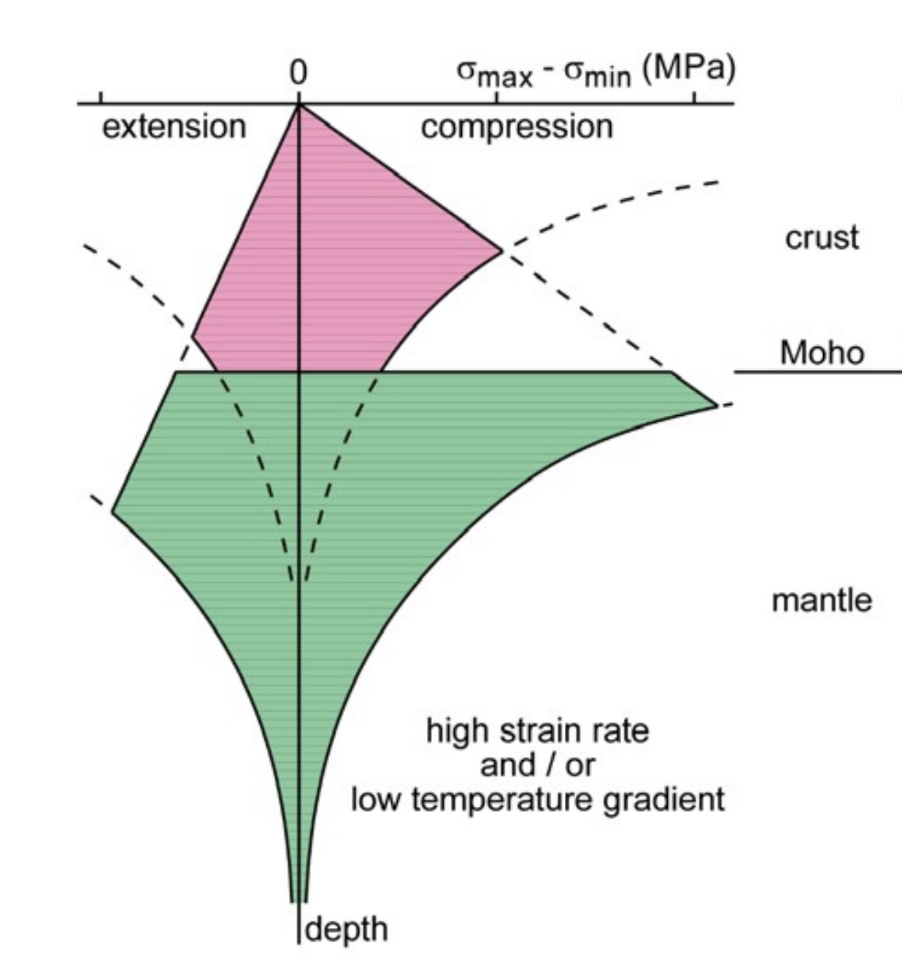
Geodynamics applications
Crust and mantle
One material
Jean-Pierre Burg @ ETHZ
Lithosphere strength profiles
(aka: Yield-strength envelopes)

Slide 45
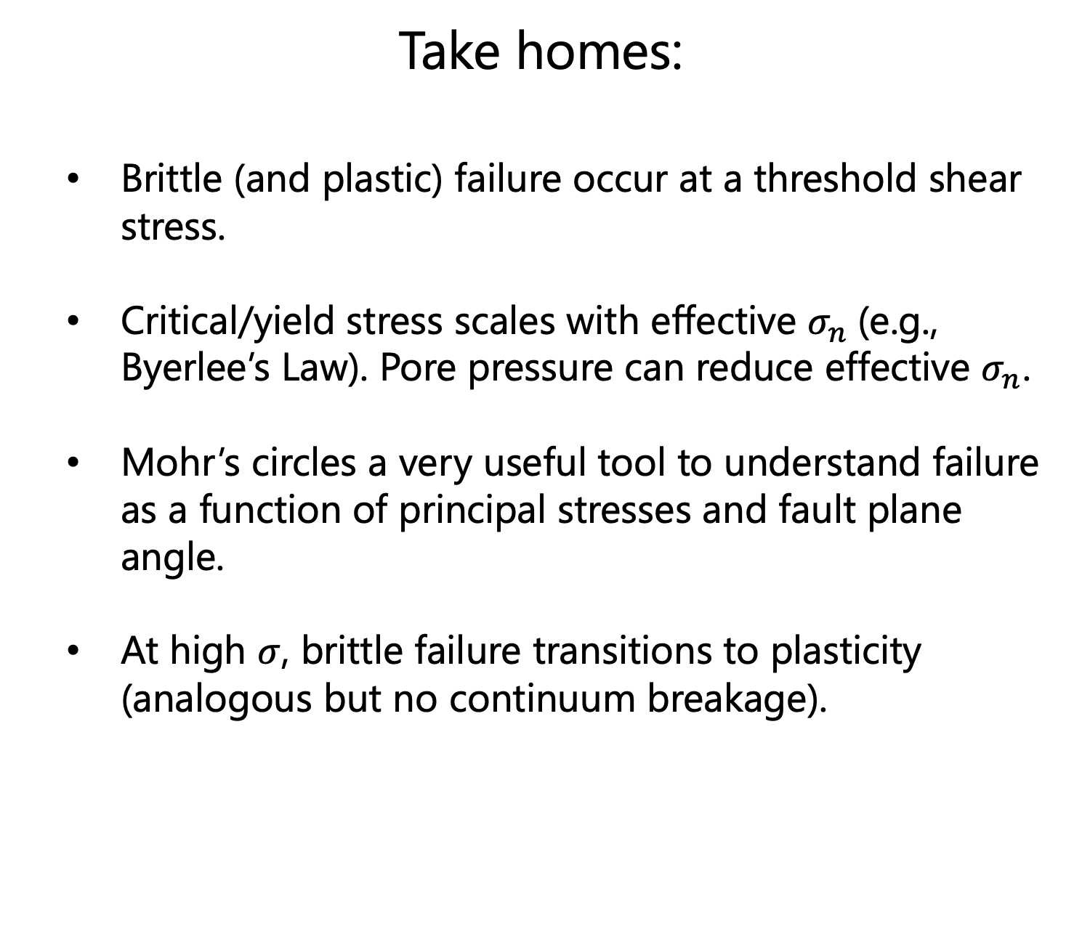
Take homes:
Brittle (and plastic) failure occur at a threshold shear stress.
Critical/yield stress scales with effective $σ_{n}$(e.g., Byerlee’s Law). Pore pressure can reduce effective $σ_{n}$.
Mohr’s circles a very useful tool to understand failure as a function of principal stresses and fault plane angle.
At high $σ$, brittle failure transitions to plasticity (analogous but no continuum breakage).

